Slide 1
Towards Online Electric Vehicle Scheduling for Mobility-On-Demand Schemes
Ioannis Gkourtzounis, Emmanouil S. Rigas and Nick Bassiliades
EUMAS 2018

Slide 2
TOC
Introduction
Problem Domain
Scheduling Algorithms: Short Mode, Long Mode
MoD Software Package: Web Platform, Mobile App
Testing and Evaluation
Summary
Let’s get started!

Slide 3
1-1. Introduction
Current personal transportation model is based on ICE vehicles
They cause high air and sound pollution
They are accountable for 74% of global CO₂ emissions
They suffer from low utilization rates of 30-35%
EVs powered by electricity from renewable sources
No tailpipe pollutants emitted
High utilization rate of more than 90%
Important role towards sustainable transportation
Ioannis Gkourtzounis, Emmanouil S. Rigas and Nick Bassiliades, EUMAS 2018

Slide 4
1-2. Introduction
Mobility-on-Demand (MoD) systems
One-way, vehicles can be picked up or dropped off at any of the stations
Two-way, vehicles have to be dropped off at their initial station
Free-floating, there are no stations, the customer can use any public parking
The vision of Future Smart Cities
MoD systems
Using fleets of EVs
Ioannis Gkourtzounis, Emmanouil S. Rigas and Nick Bassiliades, EUMAS 2018

Slide 5
1-3. Introduction
Challenges of EVs
Limited range, they need to be charged regularly
Sparse charging infrastructure, "chicken and egg problem"
EVs are still more expensive than ICE vehicles
How to incorporate EVs into MoD systems?
Charging capacity should be managed and scheduled
The maximum number of requests should be serviced
Ioannis Gkourtzounis, Emmanouil S. Rigas and Nick Bassiliades, EUMAS 2018

Slide 6
2-1. Problem Domain
The MoD system
Follows the one-way scheme
Has preconfigured stations in a geographic area
When a request is received, a scheduling algorithm is applied
A suitable vehicle is assigned to the trip request
The Agents (customers)
Announce their intention to travel between two stations
Choose the start time of the trip
Ioannis Gkourtzounis, Emmanouil S. Rigas and Nick Bassiliades, EUMAS 2018

Slide 7
2-2. Problem Domain
The scheduling algorithm
Accepts the customer requests for trips
Decides on whether to accept or deny the requests
Based on vehicles locations and their charge level
Based on all already scheduled trips data
For accepted requests, it schedules a vehicle for a trip
How can the algorithm ensure that
The maximum number of customers will be serviced?
Ioannis Gkourtzounis, Emmanouil S. Rigas and Nick Bassiliades, EUMAS 2018

Slide 8
2-3. Problem Domain
The implementation
How to store and manage all the data?
How to calculate travel times and energy cost between locations?
How to properly calculate and schedule vehicle trips?
How to implement a software package with the algorithm?
The simulation and test
How to generate requests and perform testing?
How to evaluate the test results?
Ioannis Gkourtzounis, Emmanouil S. Rigas and Nick Bassiliades, EUMAS 2018

Slide 9
3-1. Scheduling Algorithm: Short Mode
Start station: Station A
Step 1: Receive trip requests from customers
Finish station: Station B
10:15 | 10:20 | 10:25 | 10:30 | 10:35 | 10:40 | 10:45 | 10:50 | 10:55 | 11:00
10:15 | 10:20 | 10:25 | 10:30 | 10:35 | 10:40 | 10:45 | 10:50 | 10:55 | 11:00
Ioannis Gkourtzounis, Emmanouil S. Rigas and Nick Bassiliades, EUMAS 2018

Slide 10
3-2. Scheduling Algorithm: Short Mode
Start station: Station A
Step 2: Calculate trip duration and energy cost based on station coordinates
Finish station: Station B Energy required for trip: 8%
10:15 | 10:20 | 10:25 | 10:30 | 10:35 | 10:40 | 10:45 | 10:50 | 10:55 | 11:00
10:15 | 10:20 | 10:25 | 10:30 | 10:35 | 10:40 | 10:45 | 10:50 | 10:55 | 11:00
Ioannis Gkourtzounis, Emmanouil S. Rigas and Nick Bassiliades, EUMAS 2018

Slide 11
3-3. Scheduling Algorithm: Short Mode
Start station: Station A - Vehicles: EV1(86%, 10:15), EV2(5%, 10:20), EV3(22%, 10:35)
Step 3: Get available vehicles in Station A, before start time, without future routes
Finish station: Station B Energy required for trip: 8%
10:15 | 10:20 | 10:25 | 10:30 | 10:35 | 10:40 | 10:45 | 10:50 | 10:55 | 11:00
10:15 | 10:20 | 10:25 | 10:30 | 10:35 | 10:40 | 10:45 | 10:50 | 10:55 | 11:00
Ioannis Gkourtzounis, Emmanouil S. Rigas and Nick Bassiliades, EUMAS 2018

Slide 12
3-4. Scheduling Algorithm: Short Mode
Start station: Station A - Vehicles: EV1(86%, 10:15), EV2(5%, 10:20), EV3(22%, 10:35)
Step 4: Get available vehicles in Station A, with enough charge level
Finish station: Station B Energy required for trip: 8%
10:15 | 10:20 | 10:25 | 10:30 | 10:35 | 10:40 | 10:45 | 10:50 | 10:55 | 11:00
10:15 | 10:20 | 10:25 | 10:30 | 10:35 | 10:40 | 10:45 | 10:50 | 10:55 | 11:00
Ioannis Gkourtzounis, Emmanouil S. Rigas and Nick Bassiliades, EUMAS 2018

Slide 13
3-5. Scheduling Algorithm: Short Mode
Start station: Station A - Vehicles: EV1(86%, 10:15), EV2(5%, 10:20), EV3(22%, 10:35)
Step 5: Assign the candidate vehicle with the maximum charge level to the new trip
Finish station: Station B Energy required for trip: 8%
10:15 | 10:20 | 10:25 | 10:30 | 10:35 | 10:40 | 10:45 | 10:50 | 10:55 | 11:00
10:15 | 10:20 | 10:25 | 10:30 | 10:35 | 10:40 | 10:45 | 10:50 | 10:55 | 11:00
Ioannis Gkourtzounis, Emmanouil S. Rigas and Nick Bassiliades, EUMAS 2018

Slide 14
3-6. Scheduling Algorithm: Short Mode
Advantages
Fast execution
Simple implementation
Efficient for short term trip requests
Disadvantages
The algorithm searches for vehicles located in a Start station without future routes
Assigned vehicles remain unavailable until their future trip is finished
Ioannis Gkourtzounis, Emmanouil S. Rigas and Nick Bassiliades, EUMAS 2018

Slide 15
3-7. Scheduling Algorithm: Long Mode
Start station: Station A
Step 1: Receive trip requests from customers
Finish station: Station B
10:15 | 10:20 | 10:25 | 10:30 | 10:35 | 10:40 | 10:45 | ... | 12:55 | 13:00
10:15 | 10:20 | 10:25 | 10:30
Ioannis Gkourtzounis, Emmanouil S. Rigas and Nick Bassiliades, EUMAS 2018

Slide 16
3-8. Scheduling Algorithm: Long Mode
Start station: Station A
Step 2: Calculate trip duration and energy cost based on station coordinates
Finish station: Station B - Energy required for trip: 8%
10:15 | 10:20 | 10:25 | 10:30 | 10:35 | 10:40 | 10:45 | ... | 12:55 | 13:00
10:30 | 10:35 | 10:40 | 10:45
Ioannis Gkourtzounis, Emmanouil S. Rigas and Nick Bassiliades, EUMAS 2018

Slide 17
3-9. Scheduling Algorithm: Long Mode
Start station: Station A - Vehicles: EV1(7%, 10:15), EV2(6%, 10:20), EV3(22%, 10:18)
Step 3: Get available vehicles in Station A, before start time, without future routes
Finish station: Station B - Energy required for trip: 8%
10:15 | 10:20 | 10:25 | 10:30 | 10:35 | 10:40 | 10:45 | ... | 12:55 | 13:00
10:30 | 10:35 | 10:40 | 10:45
Ioannis Gkourtzounis, Emmanouil S. Rigas and Nick Bassiliades, EUMAS 2018

Slide 18
3-10. Scheduling Algorithm: Long Mode
Start station: Station A - Vehicles: EV1(7%, 10:15), EV2(6%, 10:20), EV3(22%, 10:18)
Step 4: Get available vehicles in Station A, with enough charge level
Finish station: Station B - Energy required for trip: 8%
10:15 | 10:20 | 10:25 | 10:30 | 10:35 | 10:40 | 10:45 | ... | 12:55 | 13:00
10:30 | 10:35 | 10:40 | 10:45
Ioannis Gkourtzounis, Emmanouil S. Rigas and Nick Bassiliades, EUMAS 2018

Slide 19
3-11. Scheduling Algorithm: Long Mode
Start station: Station A - Vehicles: EV3(22%, arrives: 10:18, leaves: 12:55)
Step 5: Get available vehicles in Station A, before start time, with 1 future route
Finish station: Station B - Energy required for trip: 8%
10:15 | 10:20 | 10:25 | 10:30 | 10:35 | 10:40 | 10:45 | ... | 12:55 | 13:00
10:30 | 10:35 | 10:40 | 10:45
Ioannis Gkourtzounis, Emmanouil S. Rigas and Nick Bassiliades, EUMAS 2018

Slide 20
3-12. Scheduling Algorithm: Long Mode
Start station: Station A - Vehicles: EV3(22%, arrives: 10:18, leaves: 12:55), EV4(20%, 12:10)
Step 6: Get substitute vehicles in Station A, before EV3 start time, without future routes
Finish station: Station B - Energy required for trip: 8% Substitute station: Station C
10:15 | 10:20 | 10:25 | 10:30 | 10:35 | ... | 12:10 | ... | 12:55 | 13:00
10:30 | 10:35 | 10:40 | 10:45
11:20 | 11:25 | 11:30 | 11:35
Ioannis Gkourtzounis, Emmanouil S. Rigas and Nick Bassiliades, EUMAS 2018

Slide 21
3-13. Scheduling Algorithm: Long Mode
Start station: Station A - Vehicles: EV3(22%, arrives: 10:18, leaves: 12:55), EV4(20%, 12:10)
Step 7: Get substitute vehicles, with enough charge level for the EV3 future route
Finish station: Station B - Energy required for trip: 8% Substitute station: Station C
10:15 | 10:20 | 10:25 | 10:30 | 10:35 | ... | 12:10 | ... | 12:55 | 13:00
10:30 | 10:35 | 10:40 | 10:45
11:20 | 11:25 | 11:30 | 11:35
Ioannis Gkourtzounis, Emmanouil S. Rigas and Nick Bassiliades, EUMAS 2018

Slide 22
3-14. Scheduling Algorithm: Long Mode
Start station: Station A - Vehicles: EV3(22%, 10:18), EV4(20%, arrives: 12:10, leaves: 12:55)
Step 8: Assign the substitute vehicle EV4 to the future route of EV3, now EV3 is free
Finish station: Station B - Energy required for trip: 8% Substitute station: Station C
10:15 | 10:20 | 10:25 | 10:30 | 10:35 | ... | 12:10 | ... | 12:55 | 13:00
10:30 | 10:35 | 10:40 | 10:45
11:20 | 11:25 | 11:30 | 11:35
Ioannis Gkourtzounis, Emmanouil S. Rigas and Nick Bassiliades, EUMAS 2018

Slide 23
3-15. Scheduling Algorithm: Long Mode
Start station: Station A - Vehicles: EV3(22%, 10:18), EV4(20%, arrives: 12:10, leaves: 12:55)
Step 9: Assign the candidate vehicle with the maximum charge level to the new trip
Finish station: Station B - Energy required for trip: 8% Substitute station: Station C
10:15 | 10:20 | 10:25 | 10:30 | 10:35 | ... | 12:10 | ... | 12:55 | 13:00
10:30 | 10:35 | 10:40 | 10:45
11:20 | 11:25 | 11:30 | 11:35
Ioannis Gkourtzounis, Emmanouil S. Rigas and Nick Bassiliades, EUMAS 2018

Slide 24
3-16. Scheduling Algorithm: Long Mode
Advantages
Fast execution
It also considers the future routes of other vehicles
It tries to find substitutes and make current assigned vehicles, free
Efficient for both short and long term trip requests
Disadvantages
Complex implementation
Implements only one swap between candidate and substitute vehicles
Ioannis Gkourtzounis, Emmanouil S. Rigas and Nick Bassiliades, EUMAS 2018

Slide 25
4-1. MoD Software Package
Purpose
A MoD company can monitor the state and locations of their EVs
Station and customer data can be managed through an efficient UI
Customers can make trip requests and bookings
A central system integrates the Short Mode and Long Mode algorithms
Ensuring that the highest number of people will be served in a given period
Components
Web Platform: to handle the MoD company activities and customer trip requests
Mobile App: to handle customer activities, e.g. sending trip requests
Ioannis Gkourtzounis, Emmanouil S. Rigas and Nick Bassiliades, EUMAS 2018

Slide 26
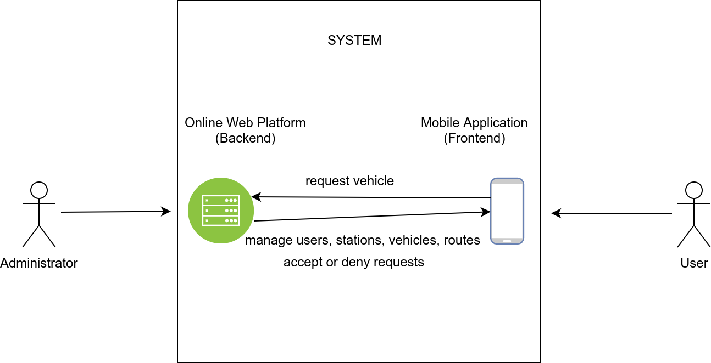
4-2. MoD Software Package
Architecture
Ioannis Gkourtzounis, Emmanouil S. Rigas and Nick Bassiliades, EUMAS 2018

Slide 27
4-3. MoD Software: Web Platform
Administrator functionalities
Upload map XML file with station coordinates
Upload vehicle XML file with vehicle characteristics
Manage user, station, vehicle and trip data
Other functionalities
Handle incoming customer trip requests
Process the requests based on the Short Mode or Long Mode algorithm
Accept or deny the trip requests
Ioannis Gkourtzounis, Emmanouil S. Rigas and Nick Bassiliades, EUMAS 2018

Slide 28
4-4. MoD Software: Web Platform
Implemented with
Java Spring MVC, a web framework with bundled modularity
Spring Security, for authentication and authorization
Spring Batch, for processing a high volume of batch operations
RESTful web service, for sending stations data to the mobile app
TCP connection, for accepting a large number of trip requests
Ioannis Gkourtzounis, Emmanouil S. Rigas and Nick Bassiliades, EUMAS 2018

Slide 29
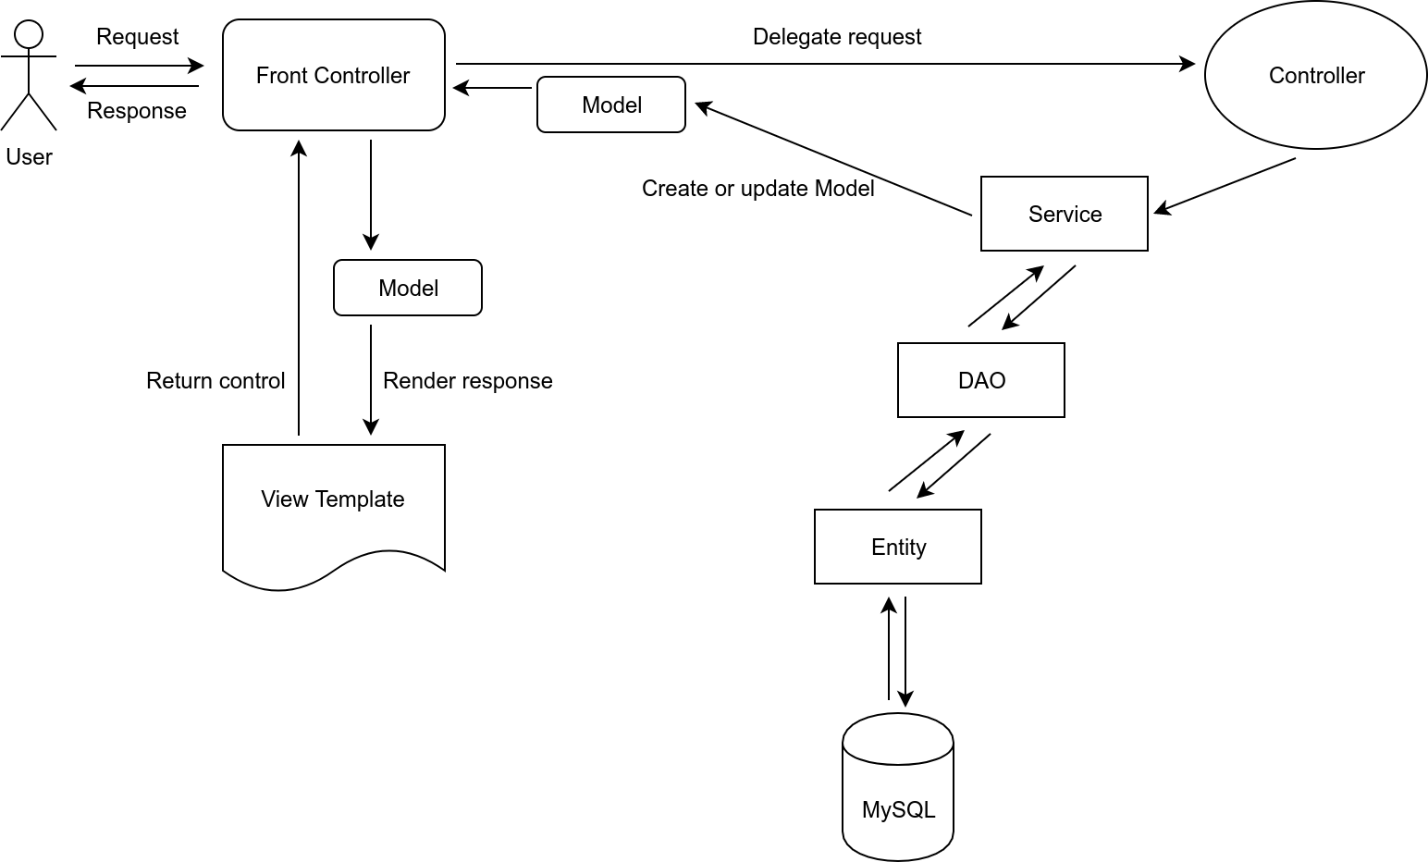
4-5. MoD Software: Web Platform
Architecture
Ioannis Gkourtzounis, Emmanouil S. Rigas and Nick Bassiliades, EUMAS 2018

Slide 30
4-6. MoD Software: Mobile App
Customer functionalities
Register and login to their profile
Select start station, finish station and start time to request a trip
See their history of the trip requests and their state (accepted or denied)
Other functionalities
Trip requests are sent to the web platform
After the process by the web platform, the mobile app saves the state of the request (accepted or denied)
Ioannis Gkourtzounis, Emmanouil S. Rigas and Nick Bassiliades, EUMAS 2018

Slide 31
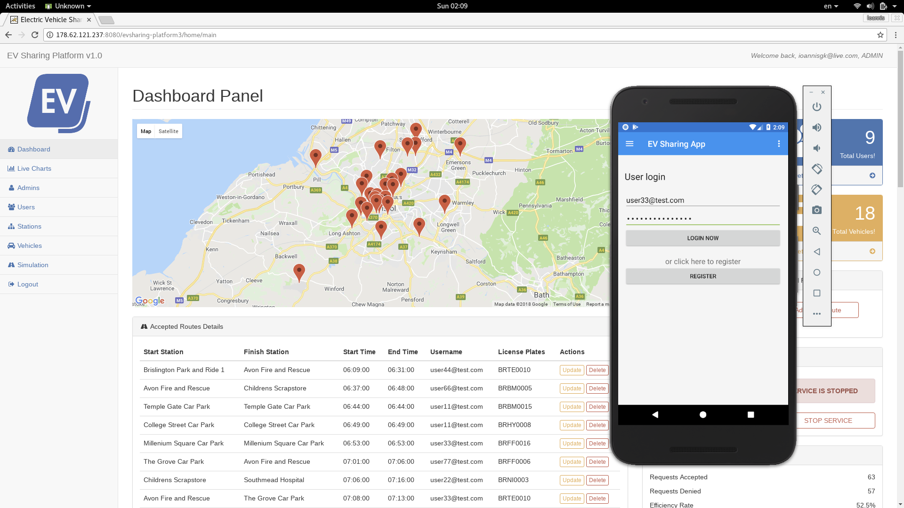
4-7. MoD Software: Mobile App
Ioannis Gkourtzounis, Emmanouil S. Rigas and Nick Bassiliades, EUMAS 2018

Slide 32
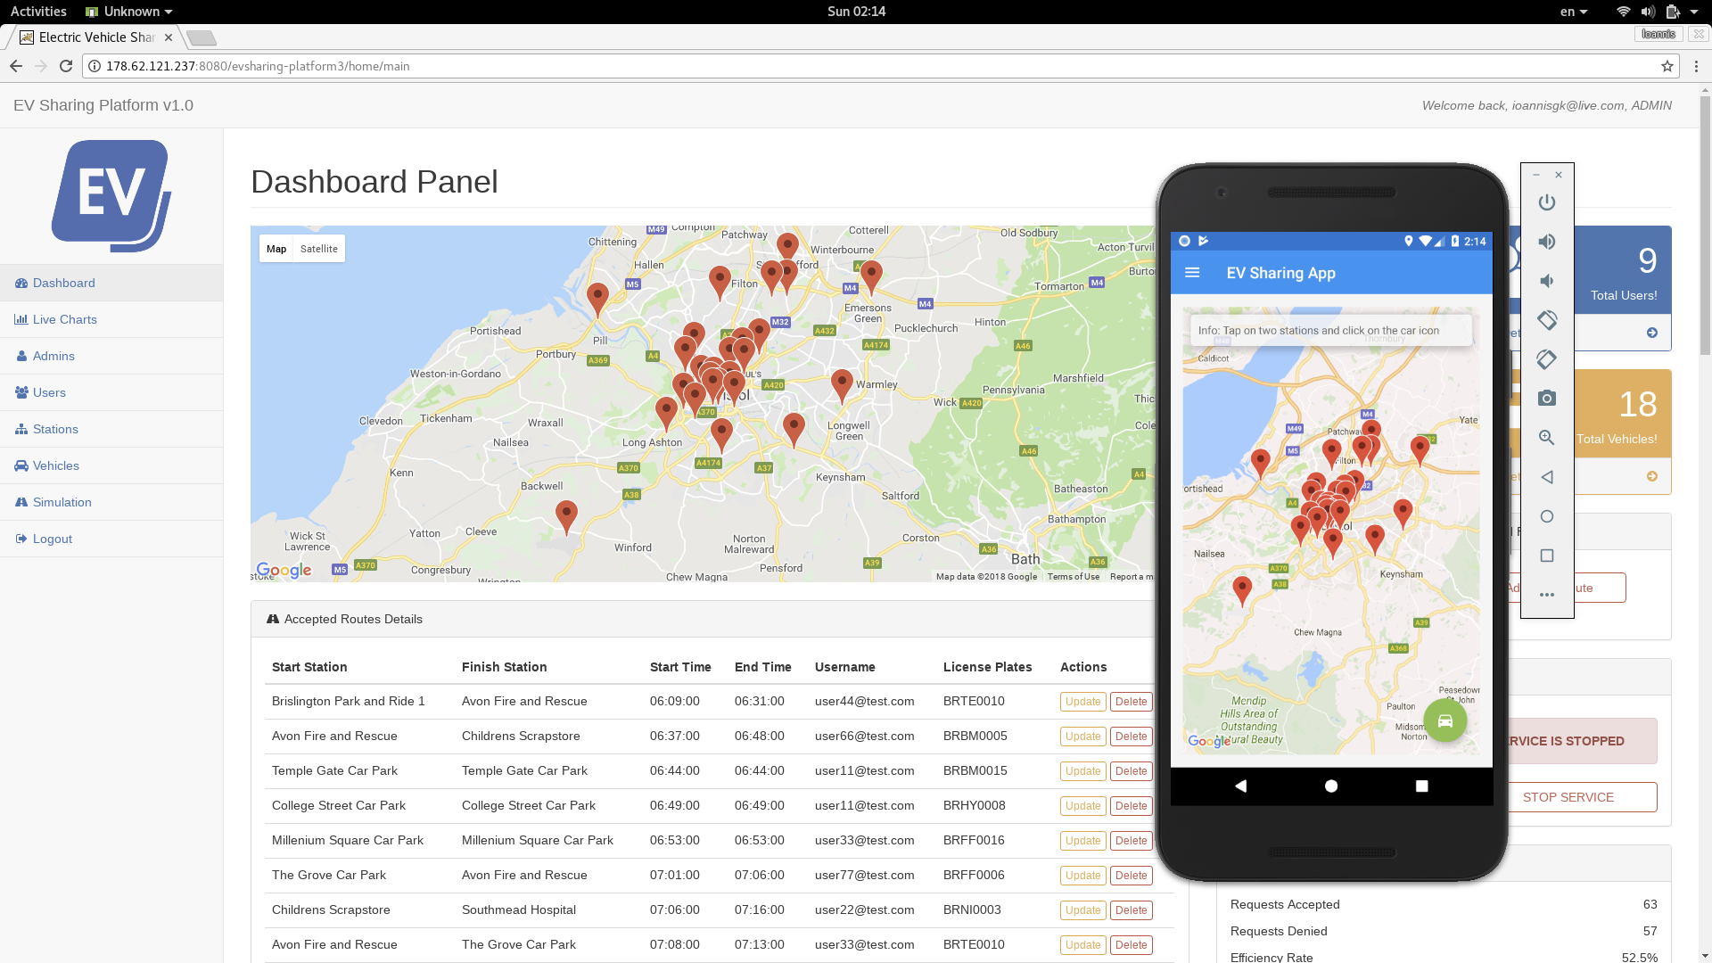
4-8. MoD Software: Mobile App
Ioannis Gkourtzounis, Emmanouil S. Rigas and Nick Bassiliades, EUMAS 2018

Slide 33
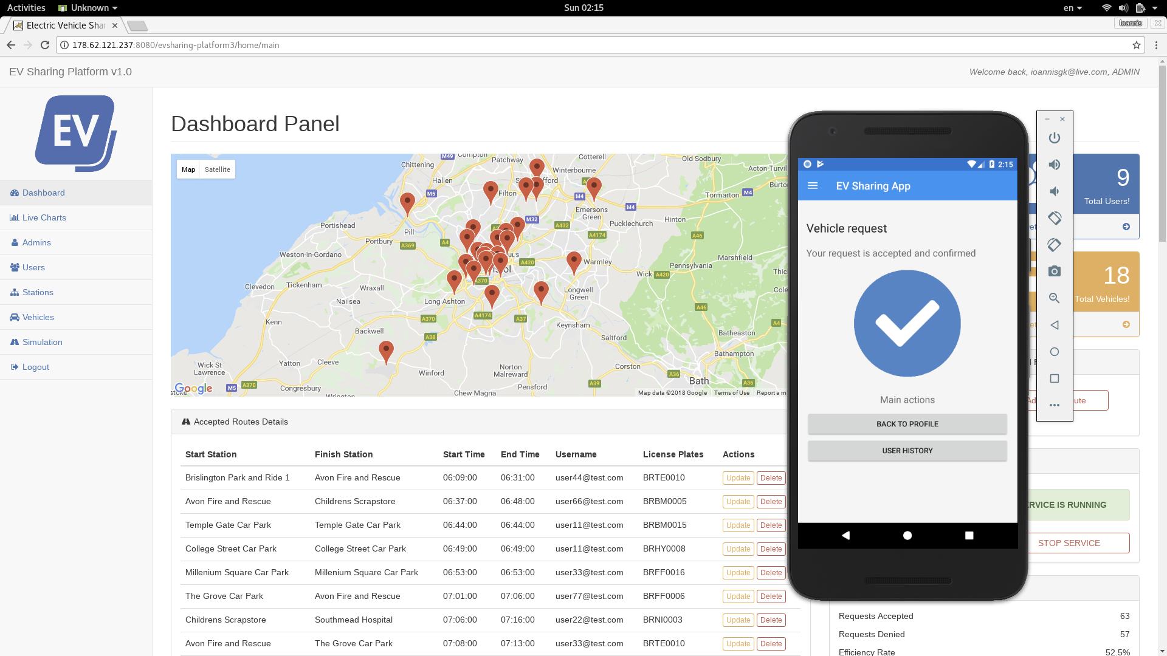
4-9. MoD Software: Mobile App
Ioannis Gkourtzounis, Emmanouil S. Rigas and Nick Bassiliades, EUMAS 2018

Slide 34
5-1. Testing and Evaluation
Step 1: Station data are uploaded via an XML file with station coordinates
Evaluation of algorithms with real data on MoD locations
Coordinates of charging stations in Bristol are used for our stations
27 stations are selected for our paradigm
The city is categorized into 5 traffic levels to resemble realistic travel conditions
We assume that the stations nearest to the center have a higher number of requests
54 vehicles with their initial locations at the stations closer to the city center
Ioannis Gkourtzounis, Emmanouil S. Rigas and Nick Bassiliades, EUMAS 2018

Slide 35
5-2. Testing and Evaluation
Step 2: Parameters to use when generating the trip requests
Parameters examined during evaluation
The maximum number of trip requests in a day
The maximum time that a user is allowed to request a vehicle in the future
The start times density factor, that essentially means how ”close” or how ”further away” in time, the start times of the trip requests are
The number of available EVs in the current MoD scheme
Ioannis Gkourtzounis, Emmanouil S. Rigas and Nick Bassiliades, EUMAS 2018

Slide 36
5-3. Testing and Evaluation
Step 3: Generate trip requests based on a mix of evaluation parameters
Requests for trips generated with our “trip requests tool”
Generated data: user id, start station id, finish station id, start time
Ioannis Gkourtzounis, Emmanouil S. Rigas and Nick Bassiliades, EUMAS 2018

Slide 37
5-4. Testing and Evaluation
Step 4: Run simulations on web platform and evaluate both algorithms
The efficiency rate is the % of the requests that get accepted and are actually scheduled
We select ranges of each of the 4 parameters
Generate 400 requests for trips for each range
Input these requests to the web platform
Let the Short Mode algorithm decide whether to accept or deny the requests
Re-import the requests and let the Long Mode algorithm decide
Document the results
Ioannis Gkourtzounis, Emmanouil S. Rigas and Nick Bassiliades, EUMAS 2018

Slide 38
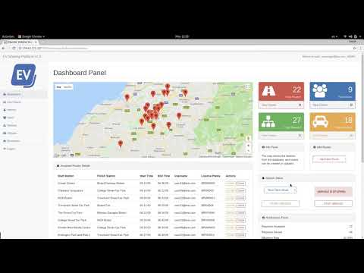
5-5. Testing and Evaluation
Ioannis Gkourtzounis, Emmanouil S. Rigas and Nick Bassiliades, EUMAS 2018

Slide 39
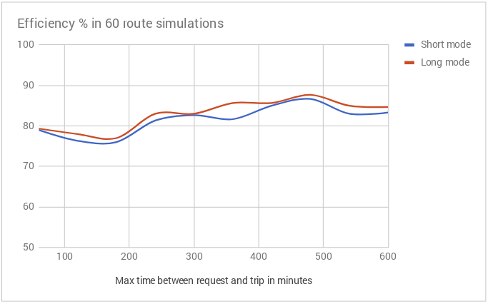
5-6. Testing and Evaluation
Observations
Long Mode has average gain of 1.40% which translates to 8.88 more minutes of travel time for every 60 requests
Long Mode has 17.8% higher execution times than Short Mode
Simulation with 27 stations and 54 EVs
Ioannis Gkourtzounis, Emmanouil S. Rigas and Nick Bassiliades, EUMAS 2018

Slide 40
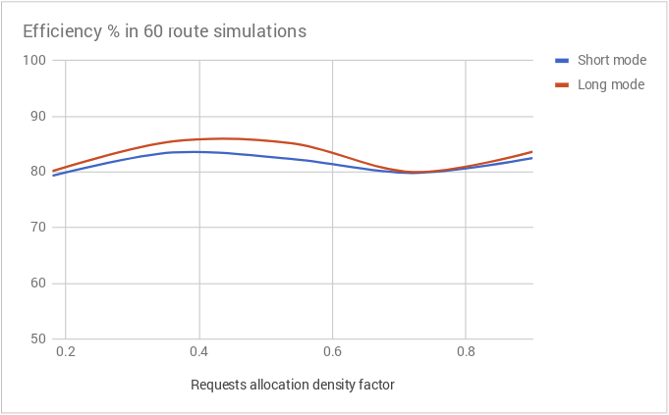
5-7. Testing and Evaluation
Observations
Long Mode has 2.84% higher efficiency rate when start times are equally shared
When start times of the requests are closer, both algorithms show the same performance
Simulation with 27 stations and 54 EVs
Ioannis Gkourtzounis, Emmanouil S. Rigas and Nick Bassiliades, EUMAS 2018

Slide 41
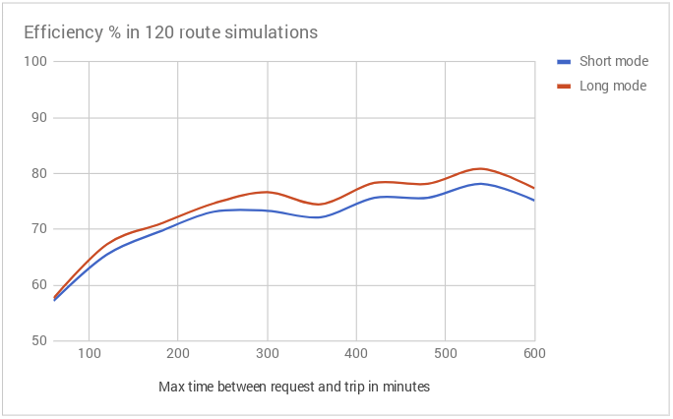
5-8. Testing and Evaluation
Observations
Long Mode average gain of 2.08% which translates to 32.5 more minutes of travel time for every 120 requests
Long Mode has 2.87% higher utilization rate than Short Mode
Simulation with 27 stations and 54 EVs
Ioannis Gkourtzounis, Emmanouil S. Rigas and Nick Bassiliades, EUMAS 2018

Slide 42
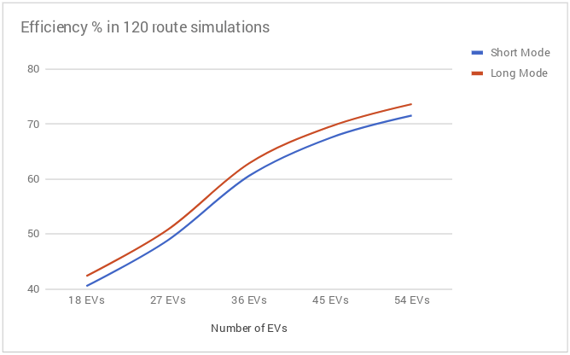
5-9. Testing and Evaluation
Observations
With 18 EVs the Long Mode has an average gain of 1.83%
When the number of EVs increases, Long Mode performance increases up to 2.08% and then it remains constant
This is expected, the Long Mode incorporates only one swap with a substitute vehicle
Ioannis Gkourtzounis, Emmanouil S. Rigas and Nick Bassiliades, EUMAS 2018

Slide 43
5-10. Testing and Evaluation
Conclusions from observations
The Long Mode algorithm performs better than the Short Mode in all tests
The Long Mode offers more gain, when the number of requests increase
When the maximum time between the start times of the requests increases, the efficiency increases
When the number of requests within the day increases, the efficiency rate drops
The Long Mode algorithm has the advantage of looking ahead for vehicles that can substitute a current candidate vehicle, so it results in better efficiency rate, but it incorporates only one such swap, so the gains are relatively small in percentage
Ioannis Gkourtzounis, Emmanouil S. Rigas and Nick Bassiliades, EUMAS 2018

Slide 44
6-1. Summary
Summary
We studied a setting where EVs can be hired to drive in an one-way MoD scheme
We proposed two scheduling algorithms for assigning EVs to trips
The Short Mode is efficient for short term reservations
The Long Mode is efficient for both short and long term ones
We designed, implemented and tested a system that consists of a web platform for administrators and a mobile app for customers
Ioannis Gkourtzounis, Emmanouil S. Rigas and Nick Bassiliades, EUMAS 2018

Slide 45
6-2. Summary
Summary
We evaluated our algorithms in a setting using real data on MoD locations
The Long Mode shows an average gain of 2.08% in respect to the Short Mode
This translates to 32.5 more minutes of travel time for every 120 requests
It achieves 2.87% higher utilization rate than Short Mode
It also enhances customer satisfaction, as it is related directly to the number of requests accepted by the system
We provided a software package and an easy way to test evaluate algorithms towards efficient online EV scheduling for MoD schemes
Ioannis Gkourtzounis, Emmanouil S. Rigas and Nick Bassiliades, EUMAS 2018

Slide 46
6-3. Summary
Video demo:
https://youtu.be/flyixErIE-A
Source code (web platform):
https://github.com/ioannisgk/evsharing-platform3-release
Source code (mobile app):
https://github.com/ioannisgk/evsharing-app-release
Ioannis Gkourtzounis, Emmanouil S. Rigas and Nick Bassiliades, EUMAS 2018

Slide 47
Thank you!
Towards Online Electric Vehicle Scheduling for Mobility-On-Demand Schemes
Ioannis Gkourtzounis - ioannisgk@live.com
Emmanouil S. Rigas - erigas@csd.auth.gr
Nick Bassiliades - nbassili@csd.auth.gr

